Slide 1
Chapter 8,9: Visualizing Distributions and more
Team 7

Slide 2
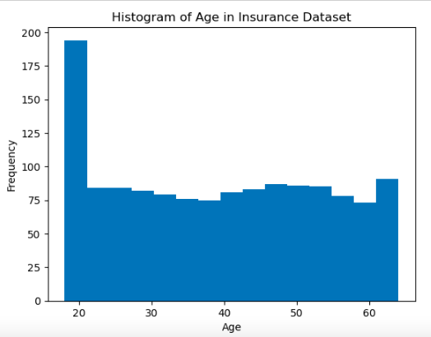
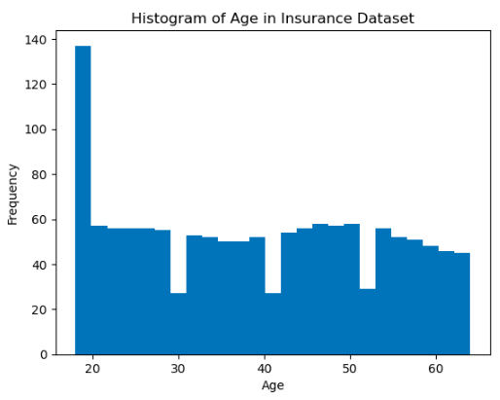
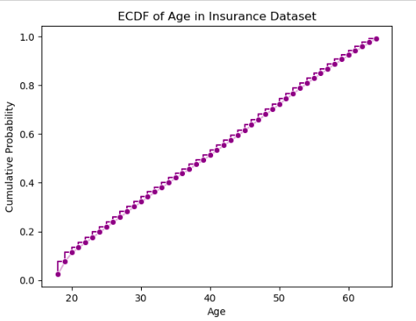
Need for ECDF & ECDF
The above graph is a histogram with bin size 10, it depicts that at Age (28,32) the distribution is normal.
The above graph is a histogram with bin size 15, it depicts that at Age 30, the frequency of people was actually lower than 29, and 31.
The above graph is plotted for Age against ECDF of the customer frequency, No outliers, or skewness, or irregularities. 38 is the median age, .
Notes:
Typically consists of series of steps, with each step representing the increase in the cumulative distribution due to an additional data point at that value.

Slide 3
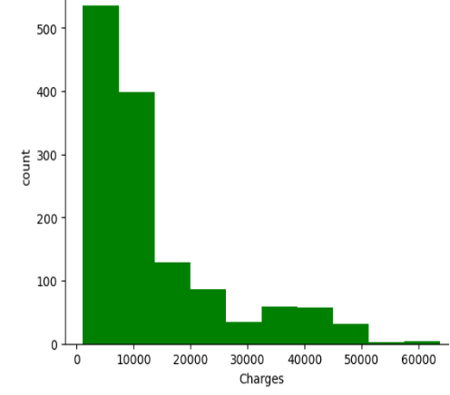
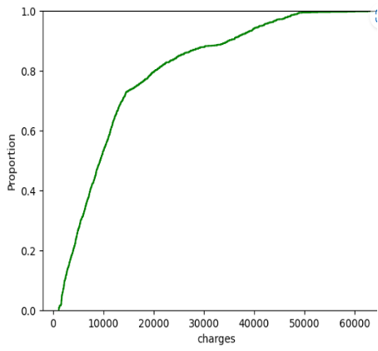
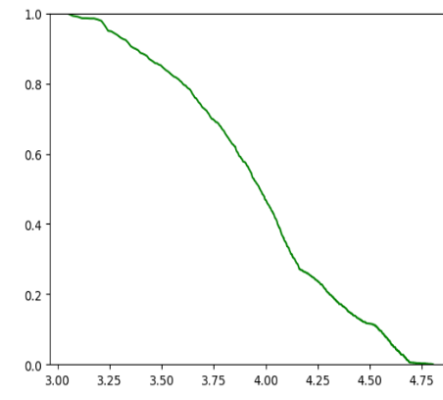
Highly skewed distributions
If we plot insurance charges claimed, we can see there are many people who have claimed insurance up to 20000, but if we consider for 60000 it becomes less frequent. This follows power law distribution. If we plot this in ECDF , there is a rise near start and again no details of distribution are visible. To get more details, we can plot using log transformation, we plot a descending ECDF with logarithmic axes, This nearly forms a straight line.

Slide 4
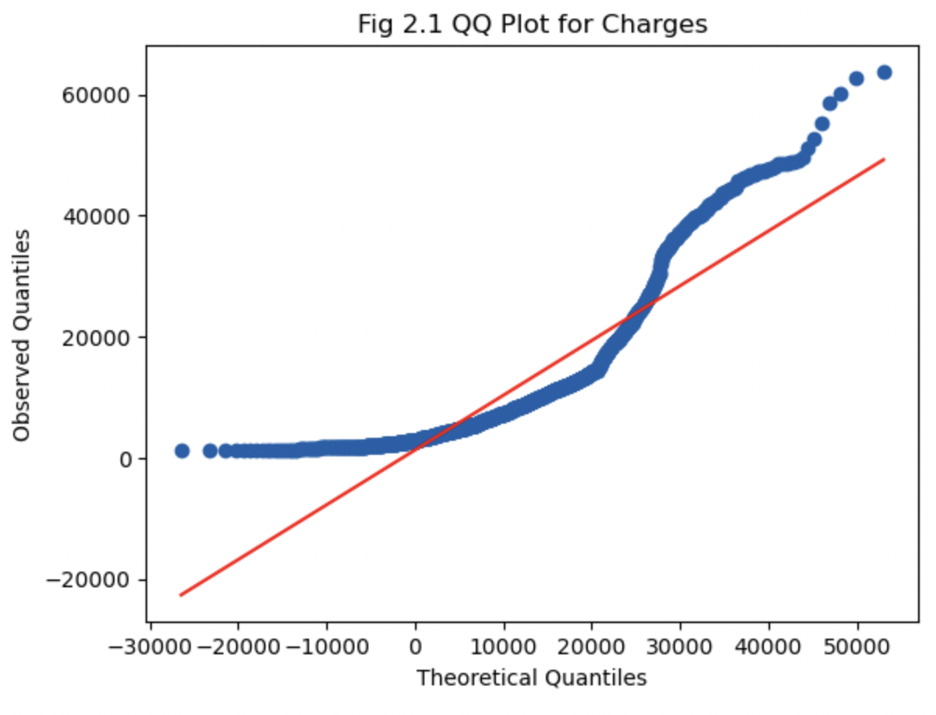
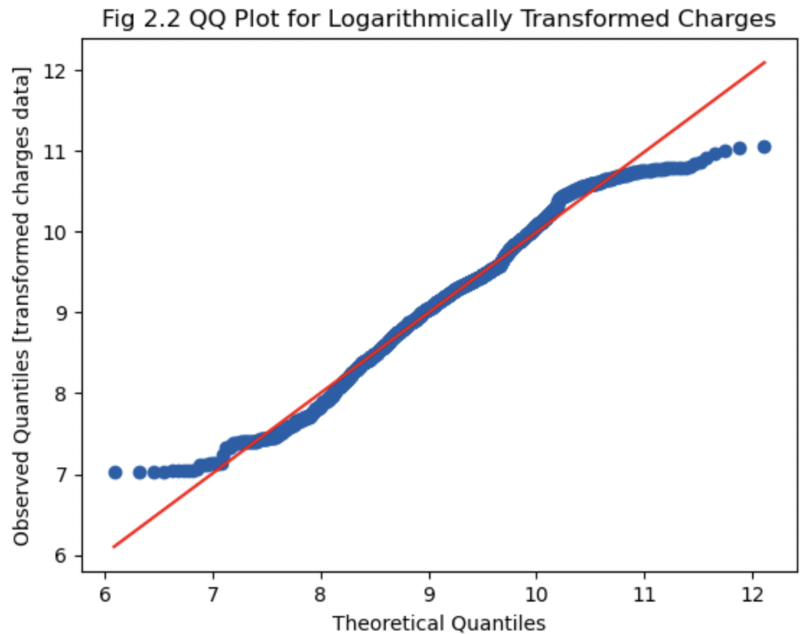

Quantile-Quantile Plots
In the below Q-Q plot, the quantiles of the two datasets being compared, such as the quantiles of the actual data and the quantiles of a normal distribution.
In Fig 2.2, The Q-Q plot of the logarithmically transformed 'charges' data suggests that it is approximately normally distributed, with very few deviations. However, in Fig 2.1, The Q-Q plot of the original ‘charges’ data indicates that it may not be perfectly normally distributed, as many data points fall out of the expected line.

Slide 5
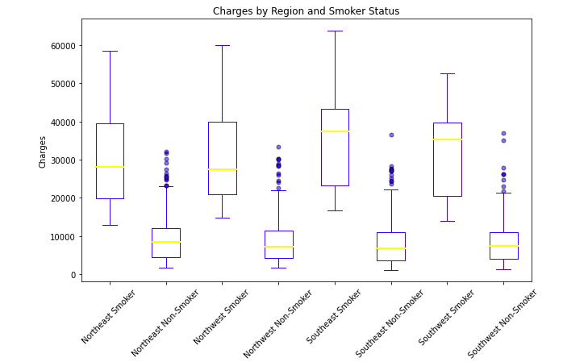
Visualizing distributions along the vertical axis
This plot shows the distribution of charges for each category of region and smoker status
The charges for smokers are higher than charges of non- smokers.
The charges in the southeast region are higher than those in northeast region
There is a great variability in charges of smokers to that of non smokers

Slide 6
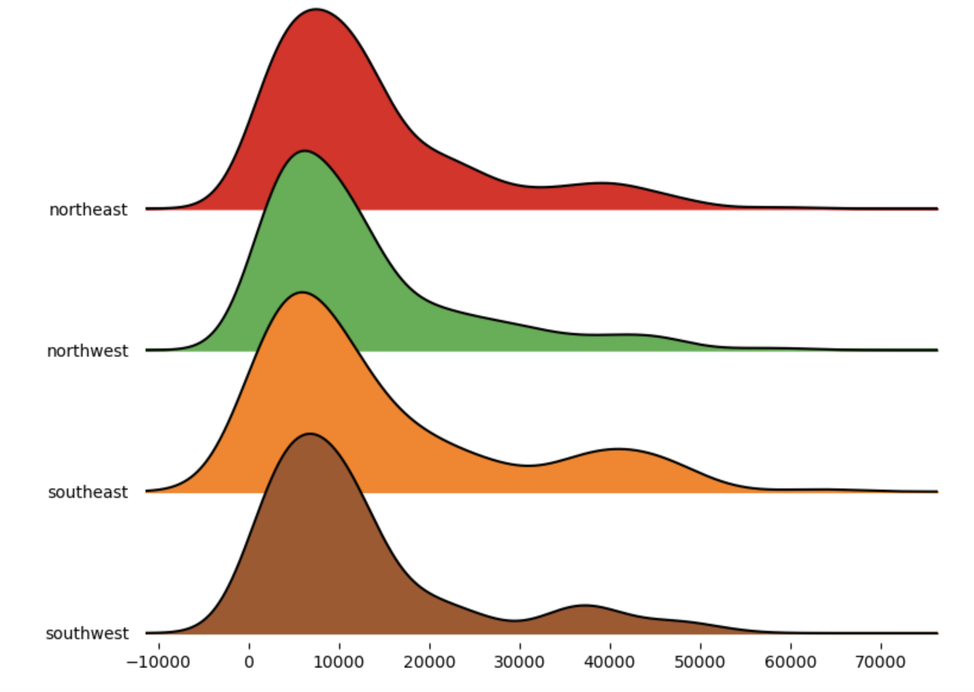
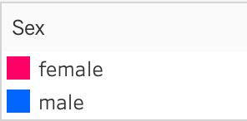
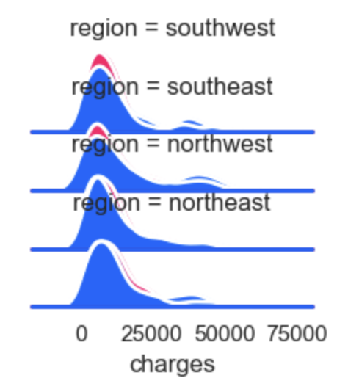
Visualizing distributions along the horizontal axis
The medical insurance charges are generally higher for males than females across all regions
In Southwest and Southeast region the median charges for female is higher than males
The density distribution of male and female are almost same otherwise
This plot shows the distribution of charges for medical insurance in different regions.
The Southeast region has the highest charges, while the Southwest has the lowest charges.
We can observe that the mean density of all region falls around 95k

Slide 7
Thank you

